Slide 1

Knowledge Graph of Printers using Social Media Posts
HP Solve 2023
Final Submission
Submitted By: Sumit Das Mohapatra

Slide 2
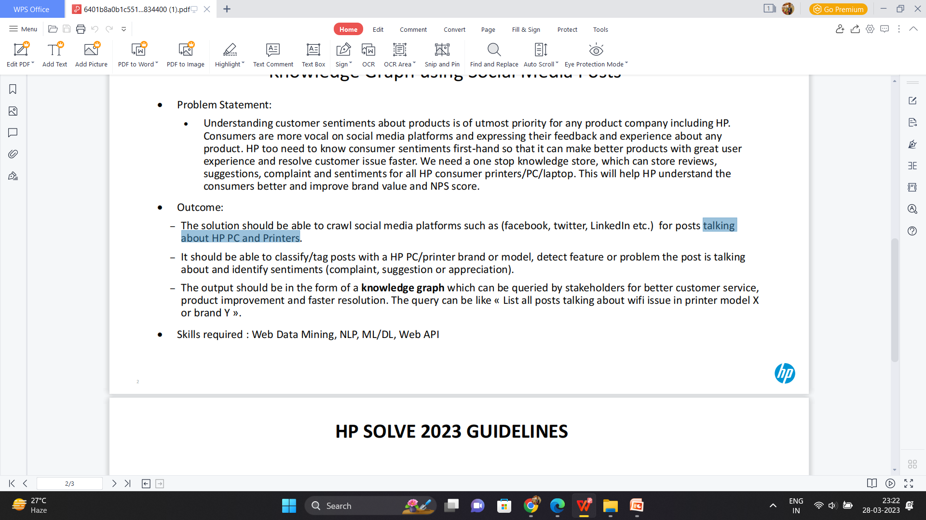
OVERVIEW:
The proposed approach aims to built an web application in which it should gather data from various social media platforms talking about HP PC and Printers, to categorized into different sections such as positive feedback, negative feedback, suggestions, complaints, etc., using the sentiment analysis tools that can help identify the sentiment of each feedback or review, store all this data in a centralized location, such as a database and based on the insights gained from analyzing the consumer sentiments, it can take action to improve its products and services.
APPROACH:
DESCRIPTION:
1. Gather Data-
Collect Data from different social media platforms by web data mining using different APIs.
It can be done using the programming language Python libraries and REST APIs.
2. Sort the Data-
After the information has been gathered, it needs to be classified into several categories, such as criticism, suggestions, compliments, complaints, etc.
By using different pandas libraries we can sort it.
Gather Data
Sort Data
Use of sentiment analysis tools
Take Appropriate Action
Use of data visualization tools
Store the data in a dataset

Slide 3
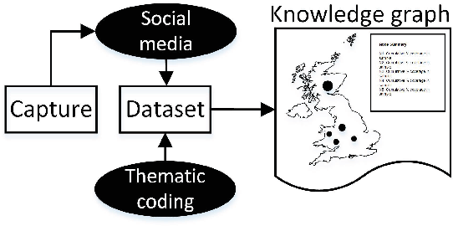
3. Use of sentiment analysis tools-
We can use sentiment analysis tools to assist determine the sentiment of each comment or review in order to further evaluate the data.
This can help stakeholder better understand how people feel generally about a certain feature or product.
4. Store the data in a database-
The storing of this information in one place, such as a database.
The data will be simpler to access and analyze as a result.
5. Use of data visualization tools-
We can use dashboards, charts, and graphs to help make sense of the data.
This makes it easier to spot patterns and trends in consumer sentiment and feedback.
6. Take Appropriate Action-
It can improve its products and services based on the knowledge gained from studying consumer sentiment.
This can involve enhancing the user experience, resolving client issues and complaints, and putting client suggestions into practice.
VALUE PROPOSITION:
Knowledge graph from above approach can be generated.
Brand value and NPS Score can be increased.
It will create a better understanding among the customers.
TECHNOLOGIES:
ML,
Python,
Web Data Mining,
NLP,
Web API

Slide 4
CODE APPROACH:
Step 1: Importing Libraries
In order to perform various tasks in Python, we import several libraries. The csv library allows us to work with CSV files, while requests enables us to make HTTP requests. The torch library is used for deep learning tasks. For data manipulation, we import pandas as pd. To create and manipulate graphs, we utilize the networkx library. Additionally, the nltk library provides tools for natural language processing, including the SentimentIntensityAnalyzer for sentiment analysis. Data visualization is facilitated by the matplotlib.pyplot library. The re library helps with regular expressions, while punctuation from string aids in handling punctuation. For text processing, we import ENGLISH_STOP_WORDS from sklearn.feature_extraction.text, and the TfidfVectorizer for text vectorization.
Step 2 : Web Scraping Data from various Social Media Platform
Web scraping data from various social media platforms allows us to gather valuable insights and information. By utilizing libraries like requests, we can send HTTP requests to specific social media platforms' APIs and retrieve data. For example, we can access Twitter's API to extract tweets or Facebook's API to retrieve posts. Additionally, tools like BeautifulSoup can be employed for parsing HTML content and extracting relevant data from web pages. This data can then be processed, analyzed, and utilized for various purposes such as sentiment analysis, trend analysis, and customer feedback analysis. Overall, web scraping enables us to leverage the vast amount of data available on social media platforms for informed decision-making and enhanced understanding of user behavior.
Step 3 : Preprocessing the data
Preprocessing the data involves transforming raw text data into a format suitable for analysis. This typically includes several steps. First, any URLs present in the text are removed using regular expressions. Next, the text is converted to lowercase to ensure consistency. Punctuation marks are then removed using the string.punctuation module. Stopwords, such as common English words, are eliminated to focus on meaningful content. The tokens are then joined back into a string. These preprocessing steps help to standardize the data, remove noise, and improve the accuracy of subsequent analyses.
Step 4: Applying Sentiment Analysis
Applying sentiment analysis involves analyzing the sentiment expressed in text data, such as social media posts or customer reviews. It helps determine the polarity of the sentiment, whether it is positive, negative, or neutral. In our approach, we utilize the SentimentIntensityAnalyzer from the nltk.sentiment module to perform sentiment analysis. This pre-trained model assigns a sentiment score to each text based on the presence of positive and negative words. By applying sentiment analysis, we can classify the sentiment of social media posts related to printers, such as identifying complaints, suggestions, or appreciation expressed by users. This information can be valuable for understanding customer sentiment, improving products, and providing better customer service.

Slide 5
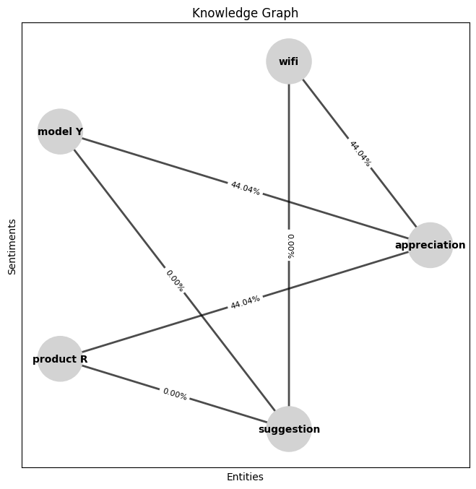
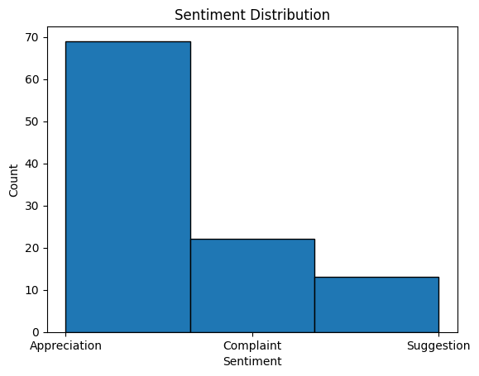
Step 5: Visualize the sentiments
To visualize the sentiments from the social media posts, we can utilize various techniques. One approach is to create a histogram, bar graph, or pie chart to display the distribution of sentiments. These visualizations provide an overview of the sentiment composition. Additionally, a box plot can be used to showcase the distribution of sentiment scores across different sentiment categories. By visually representing the sentiments, stakeholders can gain insights into customer feedback and identify areas of improvement. Visualization helps to understand the overall sentiment patterns and aids in decision-making for better customer service and product enhancements.
Step 6 : Constructing the Knowledge Graph
Constructing the knowledge graph involves several steps. First, we import the necessary libraries, such as NetworkX for graph manipulation and NLTK for sentiment analysis. Next, we read the preprocessed data and extract relevant information, including the brand, model, feature, problem, and sentiment. We then create nodes in the knowledge graph for each entity type, such as printer brands, models, features, and problems. We establish relationships between the nodes by adding edges to represent connections, such as posts mentioning a specific brand or discussing a particular feature or problem. Finally, we store the collected data and sentiment labels in the knowledge graph, enabling stakeholders to query and gain insights for customer service, product improvement, and faster resolution.

Slide 6
FUTURE SCOPE:
To enhance the code further, consider implementing advanced sentiment analysis algorithms for more precise sentiment scores. Employ natural language processing techniques to extract key features from the tweets, including the specific problems or features being discussed. Additionally, leverage machine learning algorithms to identify patterns in the data and make predictions on future trends. These enhancements can lead to improved accuracy and provide valuable insights for customer service, product enhancement, and forecasting.
ABOUT ME:
I am Sumit Das Mohapatra, a passionate and dedicated student currently in my 4th year of B.Tech. in Computer Science and Engineering at Odisha University of Technology and Research. I have a strong interest in both Full Stack Development and Machine Learning. Recently, I had the privilege to participate in HP Solve 2.0, where I competed against some of the brightest minds in India. I put my best efforts into creating an optimal and user-friendly solution that is reliable, precise, and efficient. I am excited to share my solution with you all and discuss how it can contribute to solving real-world challenges.
Thank You…

